Slide 1
Databricks-primary Architecture
Modern Data Platform — v8.0
Greenfield | Architecture & Data Engineering | March 2026
REFERENCE ARCHITECTURE

Slide 2
Executive Summary
9,000
55,000+
3
2
IT Workforce
Employees
Tech Pillars
Azure Regions
Unified lakehouse platform across all business domains
1
Seamless integration: Databricks ↔ Fabric ↔ SAS Viya
2
Enterprise governance with Unity Catalog + Purview + Manta
3
Multi-cloud ready with Private Link end-to-end security
4

Slide 3
Table of Contents
1
Context & Strategic Drivers
2
Architecture Overview
3
Medallion Architecture
4
Analytics & BI
5
AI/ML Platform
6
Data Governance
7
Security & Compliance
8
FinOps & Operations

Slide 4
1
SECTION 1
Context & Strategic Drivers
Business mandate and architectural principles
Greenfield | Modern Data Platform | Databricks-primary v8.0

Slide 5
Business Mandate
Regulatory Compliance
Data Democratisation
AMF, OSFI, Law 25 controls integrated at platform level
Self-service analytics with semantic layer governance
AI/ML at Scale
Operational Efficiency
Enterprise MLOps with governance and reproducibility
Cost transparency, automated scaling, FinOps chargeback

Slide 6
Architecture Principles
Open Formats
Security by Design
Federated Governance
Delta Lake, Apache Spark, Unity Catalog
Zero-trust network, encryption everywhere, PBAC
Central policy, local execution, domain ownership
Cloud-Native
Cost Transparency
Vendor Portability
Managed services, auto-scaling, elastic compute
Usage-based billing, chargeback, optimization
Multi-region, multi-cloud ready, no vendor lock-in

Slide 7
2
SECTION 2
Architecture Overview
Platform topology and technology pillars
Greenfield | Modern Data Platform | Databricks-primary v8.0

Slide 8
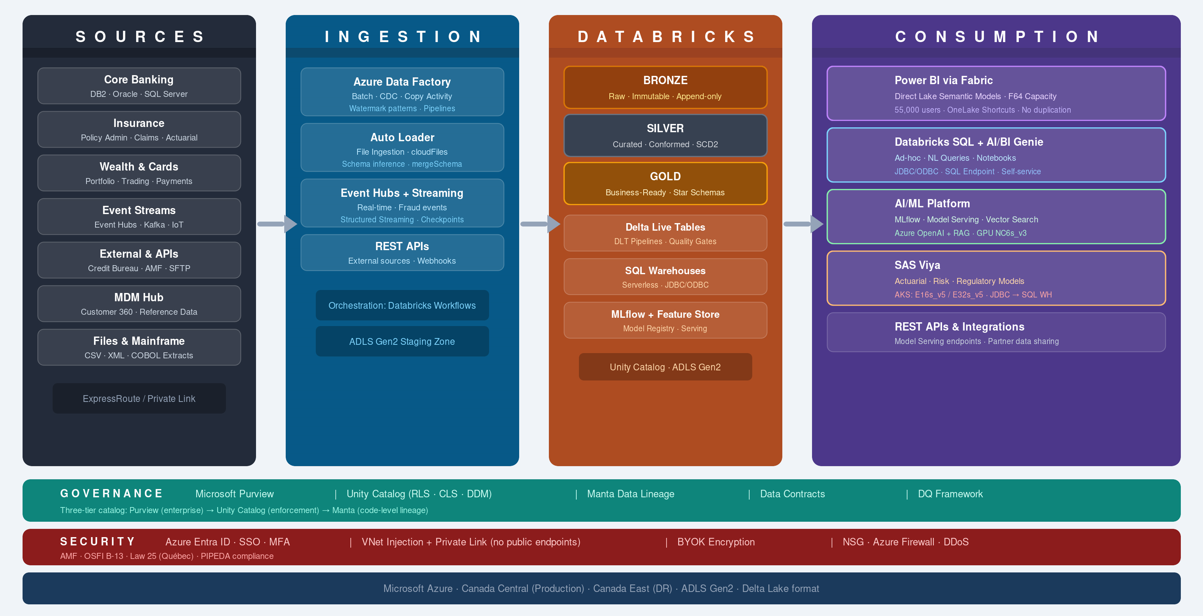
High-Level Architecture

Slide 9
Technology Pillars
Databricks
Microsoft Fabric / Power BI
SAS Viya
Lakehouse + Analytics
Semantic Layer
Regulated Analytics
Delta Lake & SQL
Self-Service BI
Actuarial Models
MLflow & AI/ML
Real-Time Analytics
Advanced Statistics
Unity Catalog
Governance Integration
Azure AKS Hosting

Slide 10
Azure Platform Foundation
Microsoft Azure — Canada Central (Prod) + Canada East (DR)
ADLS Gen2
Databricks Workspace
Key Vault
Event Hubs
ADF
AKS (SAS)
App Service
Azure Monitor
Private Endpoints
Log Analytics
App Insights
Container Registry
Function Apps
ExpressRoute
DDoS Protection

Slide 11
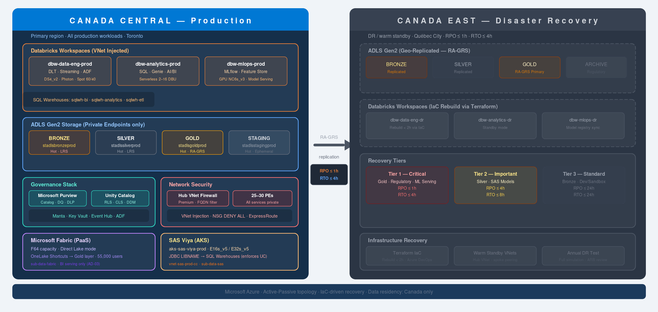
Deployment Topology

Slide 12
Network Architecture
SPOKE 1: Databricks VNet
HUB VNet
ADB-managed VNet
On-Premises
Databricks subnet (10.x.x.x)
ExpressRoute
Firewall (central egress)
▶
Private Link endpoints
Bastion (jump host)
Hub → Spoke peering
NSGs / UDRs
BGP route propagation
Private DNS zones
▶
Private Link
ADLS Gen2 | Key Vault | Event Hubs | SQL | Service Bus

Slide 13
Environment Strategy
DEV
UAT
PROD
banking_dev
banking_uat
banking_prod
insurance_dev
insurance_uat
insurance_prod
wealth_dev
wealth_uat
wealth_prod
ent_shared
ent_shared
ent_shared

Slide 14
3
SECTION 3
Medallion Architecture
Bronze → Silver → Gold data layers
Greenfield | Modern Data Platform | Databricks-primary v8.0

Slide 15
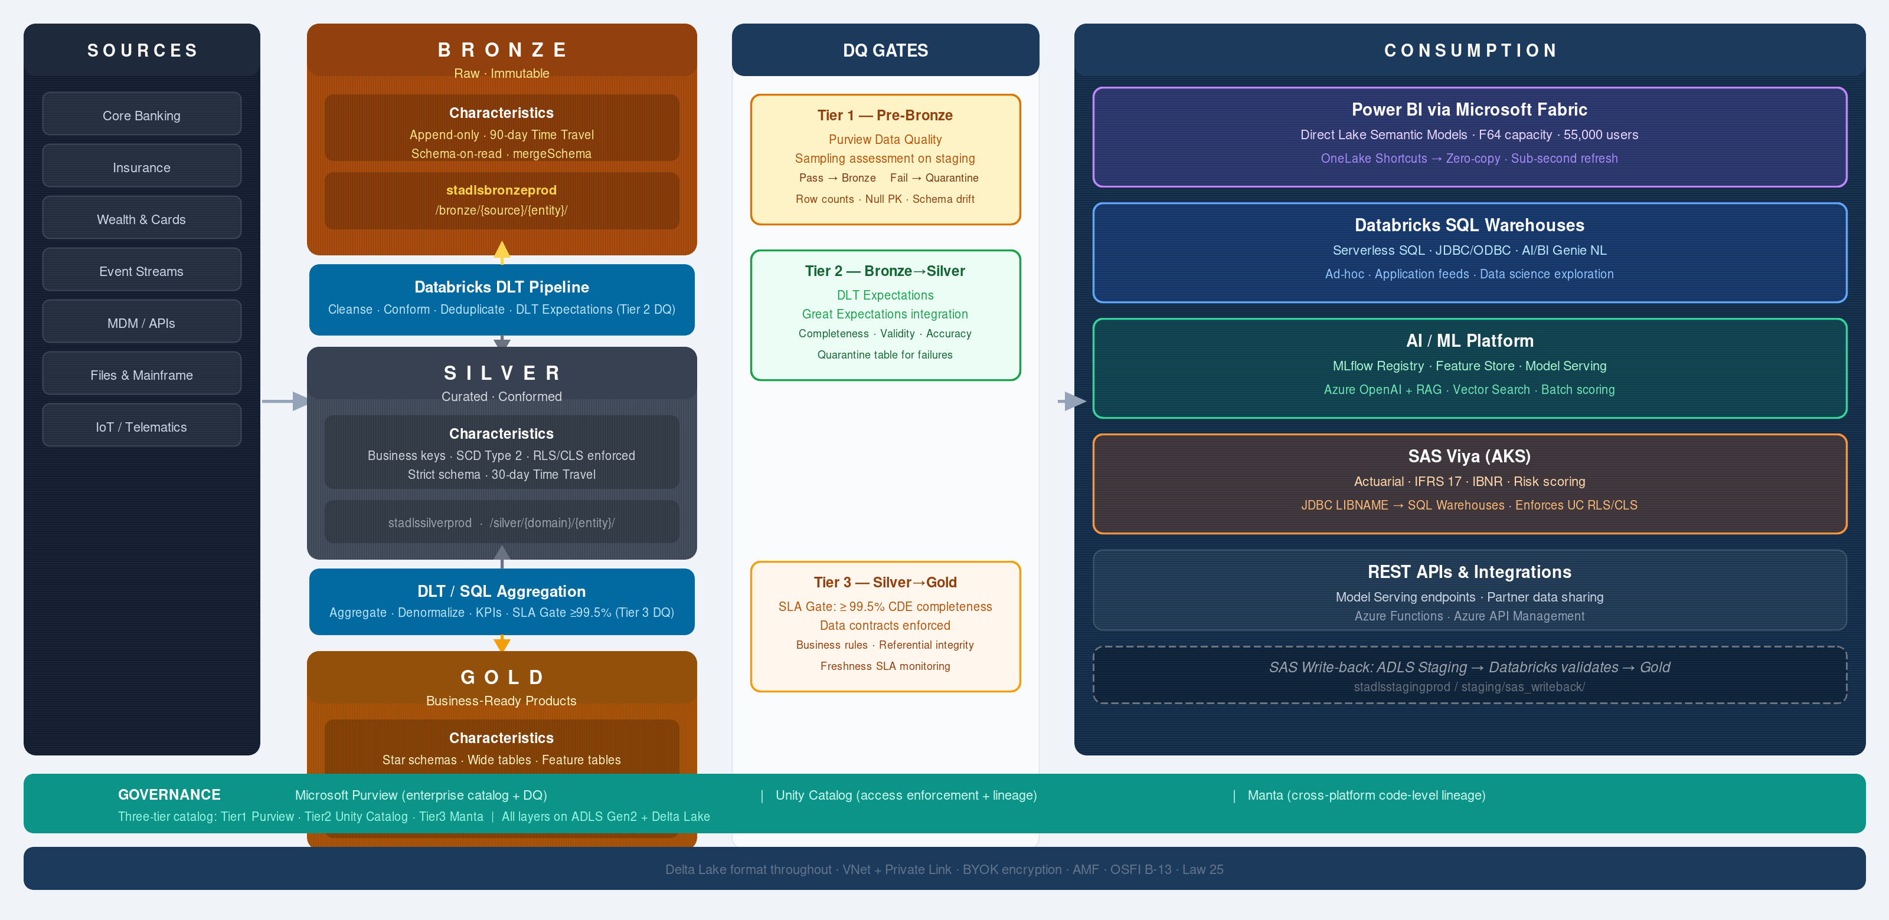
Medallion Overview

Slide 16
Bronze Layer
SOURCES
• Raw data in native format (JSON, CSV, Parquet)
On-Prem
SaaS
APIs
• Full change data capture and history
▼
Streaming
INGESTION
• Minimal schema validation
ADF
Autoloader
Event Hubs
• Autoloader auto-detects and loads
▼
BRONZE
Raw Delta
• Partition by source and load date
No Transform
• Quarantine bad records for investigation

Slide 17
Silver Layer
BRONZE
• Deduplication and cleansing
Raw tables
• Schema conformance and validation
▼
TRANSFORM
• Removal of PII where applicable
DLT Jobs
SQL/PySpark
• Data quality expectations enforced
▼
SILVER
• Fact + dimension design patterns
Clean tables
Conformed
• Incremental load optimization

Slide 18
Gold Layer
SILVER
• Business aggregations and KPIs
Clean tables
• Dimensional modeling (star schema)
▼
AGGREGATION
• Pre-computed metrics and features
Analytics job
ML prep
• Optimized for BI and ML consumption
▼
GOLD
• Published with data dictionary
Agg tables
BI ready
• SLA-backed by SLOs and DQ gates

Slide 19
Delta Lake Foundation
ACID Transactions
Time Travel
Serializability guarantees with snapshot isolation
Query historical versions; restore to any point in time
Schema Enforcement
Unified Batch+Streaming
Automatic schema validation on writes
Same table = batch and streaming workloads

Slide 20
Data Ingestion Patterns
BATCH (ADF)
STREAMING
Scheduled
Event Hubs
pipelines
Kafka
→ Autoloader
→ Autoloader
API GATEWAY
FILE DROP
REST API
SFTP/Blob
Custom
Landing
→ Functions
→ Autoloader

Slide 21
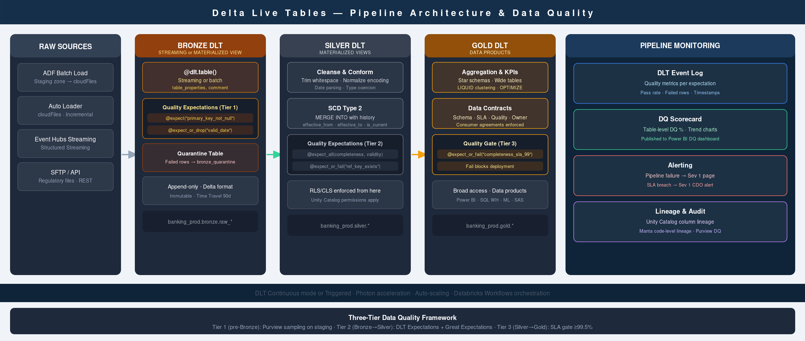
Delta Live Tables (DLT)

Slide 22
4
SECTION 4
Analytics & BI
Consumption layer: Power BI, SAS, self-service
Greenfield | Modern Data Platform | Databricks-primary v8.0

Slide 23
Analytics Architecture
GOLD
▶
SQL WH
▶
Power BI
▶
Users
Tables
Dashboards
Reports
Dashboards
GOLD
▶
SAS Viya
▶
Reports
▶
Users
Actuarial
Models
Outputs
Insights
Self-Service Analytics (AI/BI Genie)
Gold Tables
Natural Language
Auto-Generated
All curated
Questions
Reports
data
▶
Prompts
▶
Visualizations
Insights

Slide 24
Databricks SQL Warehouse
Serverless
• Standard SQL endpoint for BI tools
Auto-scaling, pay-per-request
• JDBC/ODBC connectors (Power BI, Tableau)
Pro
Managed, burstable, reserved capacity
• Query result caching (delta skip)
Classic
• Parameterized queries and alerts
Standard, legacy deployments
• Query history and audit logging
• Performance insights and explain plans

Slide 25
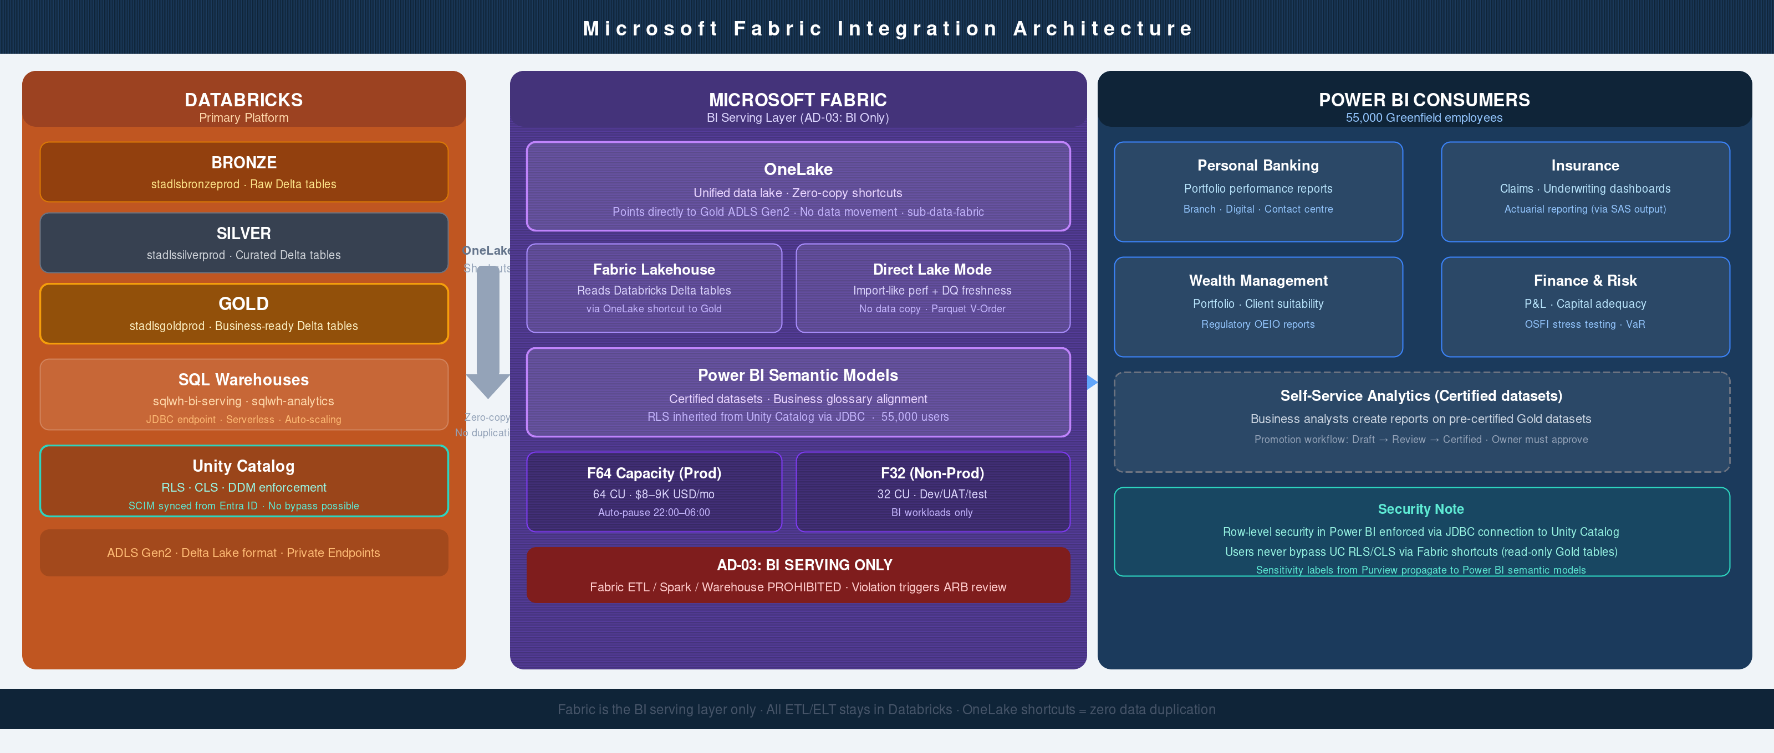
Microsoft Fabric Integration

Slide 26
Power BI Semantic Layer
GOLD
DirectQuery
/ Import
Semantic Model
Reports
Users
Delta Tables
Connection Mode
Measures, DAX
Visuals, Pages
Insights
▶
▶
▶
▶
• Star schema in semantic model for performance
• Row-level security (RLS) for multi-tenant access
• Aggregations for interactive dashboard acceleration
• Premium capacity for enterprise SLA
• Refresh schedules aligned with Gold table SLOs

Slide 27
SAS Viya Integration
SAS VIYA
GOLD LAYER
ACTUARIAL
On Azure AKS
ADLS Gen2
Models
High availability
▶
Private EP
▶
Outputs
Regulated
Migration Path: SAS 9.4 → SAS Viya
• SAS 9.4 on Windows Server → SAS Viya on AKS
• Greenfield SAS Viya cluster = 2 x SAS 9.4 data sources
• Data sourced from Gold layer (ADLS Gen2 shortcuts)
• Viya reads via Private Endpoint (no public IP)
• Actuarial models: auto-executed every month

Slide 28
5
SECTION 5
AI/ML Platform
MLOps, feature engineering, model serving
Greenfield | Modern Data Platform | Databricks-primary v8.0

Slide 29
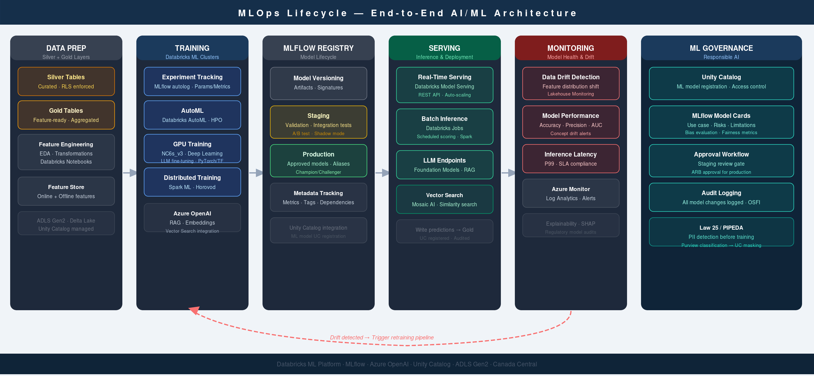
AI/ML Architecture

Slide 30
MLflow Lifecycle
Experiment
Track Runs
Model Registry
Stage
Deploy
Monitor
▶
▶
▶
▶
▶
Code + Config
Params, Metrics
Versions
Staging → Prod
REST / Batch
Drift, Metrics
• Automatic logging of parameters, metrics, artifacts
• Reproducible runs with model state snapshots
• A/B testing framework for model comparison
• Callbacks for automated retraining on drift
• Integration with Databricks Jobs for CI/CD

Slide 31
Feature Engineering
Feature Store Architecture
SILVER
• Databricks Feature Store (point-in-time lookup)
Raw Features
• Versioning and lineage tracking
▼
FEATURE
• Online + offline feature serving
Engineered
Features
• Point-in-time joins for training/serving skew
▼
REGISTRY
Versioned
• Data quality monitoring on features
Features
• Automatic feature recomputation schedules

Slide 32
Model Serving & Deployment
MODEL
REAL-TIME
INFERENCE
Registry
▶
REST API
▶
Predictions
Versions
Endpoints
Score
BATCH
PREDICT
STORE
Jobs
▶
Bulk scoring
▶
Gold tables
Scheduled
Results
Results
Monitoring & Feedback
• Model performance drift detection (skew + drift)
• Prediction quality monitoring vs. actual outcomes
• Automated retraining triggers on threshold breach
• A/B testing framework for champion/challenger
• Cost tracking and resource optimization

Slide 33
6
SECTION 6
Data Governance
Unity Catalog, Purview, Manta, DQ framework
Greenfield | Modern Data Platform | Databricks-primary v8.0

Slide 34
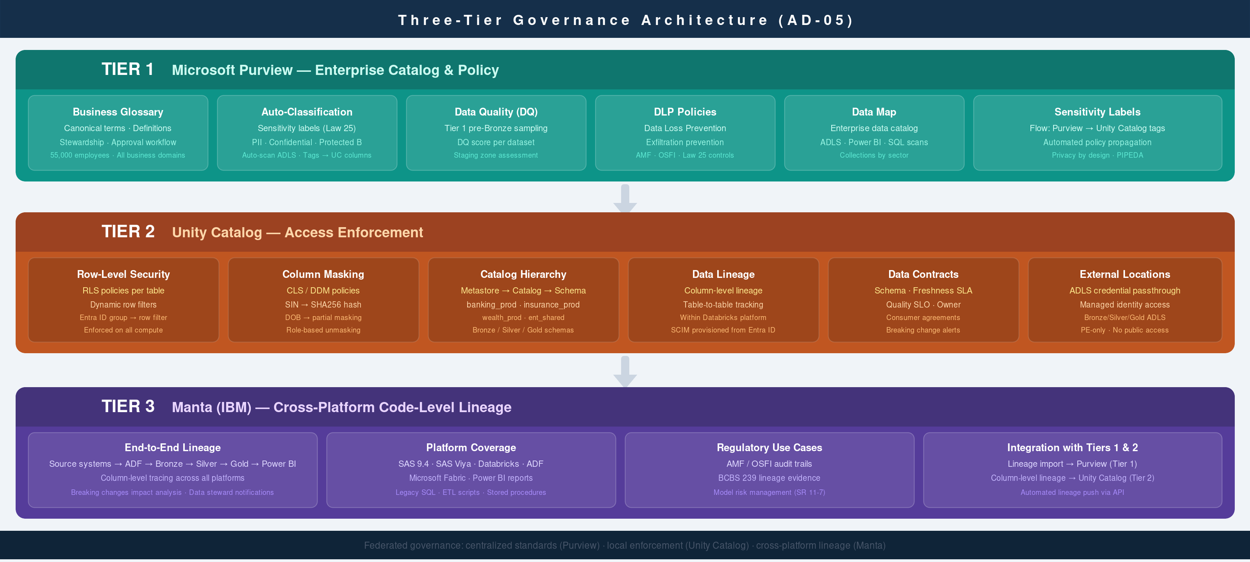
Governance Architecture

Slide 35
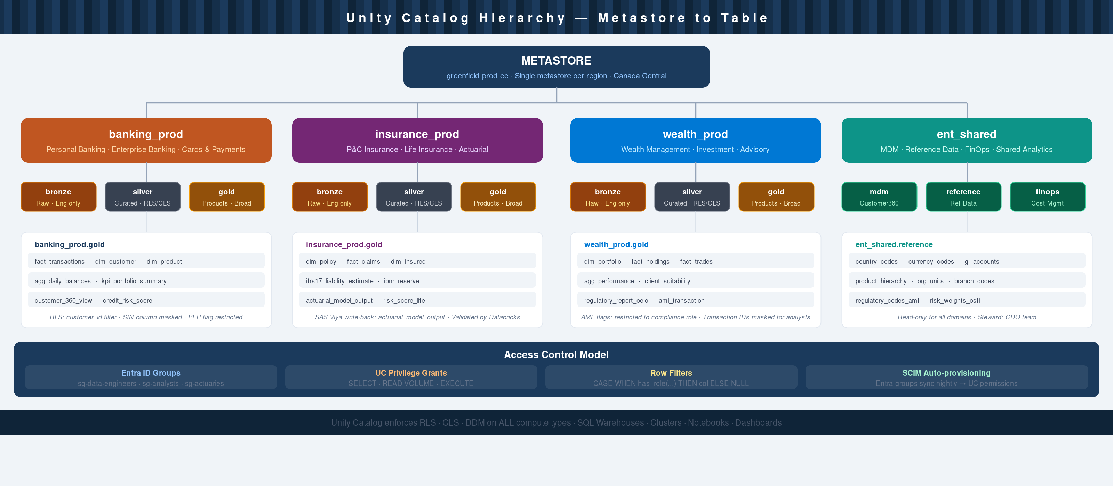
Unity Catalog — Hierarchy

Slide 36
Unity Catalog — Security Model
USER/GROUP
UC GRANT
TABLE ACCESS
DATA
Entra ID
▶
SELECT
▶
Row filter
▶
Controlled
SCIM
MODIFY
Column mask
Access
• Attribute-Based Access Control (ABAC) on tables
• Column-level masking for PII (redaction, hashing)
• Row-level filtering for multi-tenant isolation
• Inheritance from catalog → schema → table
• Audit log of all grant/revoke operations

Slide 37
Microsoft Purview Integration
MS PURVIEW
Data Map
Governance
UNITY CATALOG
ADLS Gen2
MANTA
POWER BI
scanned
scanned
scanned
scanned
Sensitivity Labels
• Public / Internal / Confidential / Restricted labels auto-applied
• Labels flow to Unity Catalog column masks and Fabric
• Compliance reports generated for regulatory audits
• Data discovery via Purview portal for data mesh

Slide 38
Manta Data Lineage
SOURCES
PIPELINES
BRONZE
SILVER
GOLD
▶
▶
▶
▶
On-Prem
ADF
Raw
Clean
Agg
▼
REPORTS
BI
Column-Level Lineage Tracking
• Source column → Bronze raw → Silver transformed → Gold aggregated
• Manta integrates Unity Catalog + ADF pipelines + Databricks jobs
• Impact analysis: which reports if source field changes?
• Data quality cascade: detect upstream issue, auto-alert downstream
• GDPR/privacy traceability for right-to-be-forgotten requests

Slide 39
Data Quality Framework
DETECTION
MEASUREMENT
REMEDIATION
DLT expectations
DQ score per table
Auto-alert steward
Great Expectations
Sector KPI dashboard
SLA enforcement
ML-based anomalies
SLO compliance %
Root cause analysis

Slide 40
7
SECTION 7
Security & Compliance
Defense in depth, identity, encryption, regulatory
Greenfield | Modern Data Platform | Databricks-primary v8.0

Slide 41
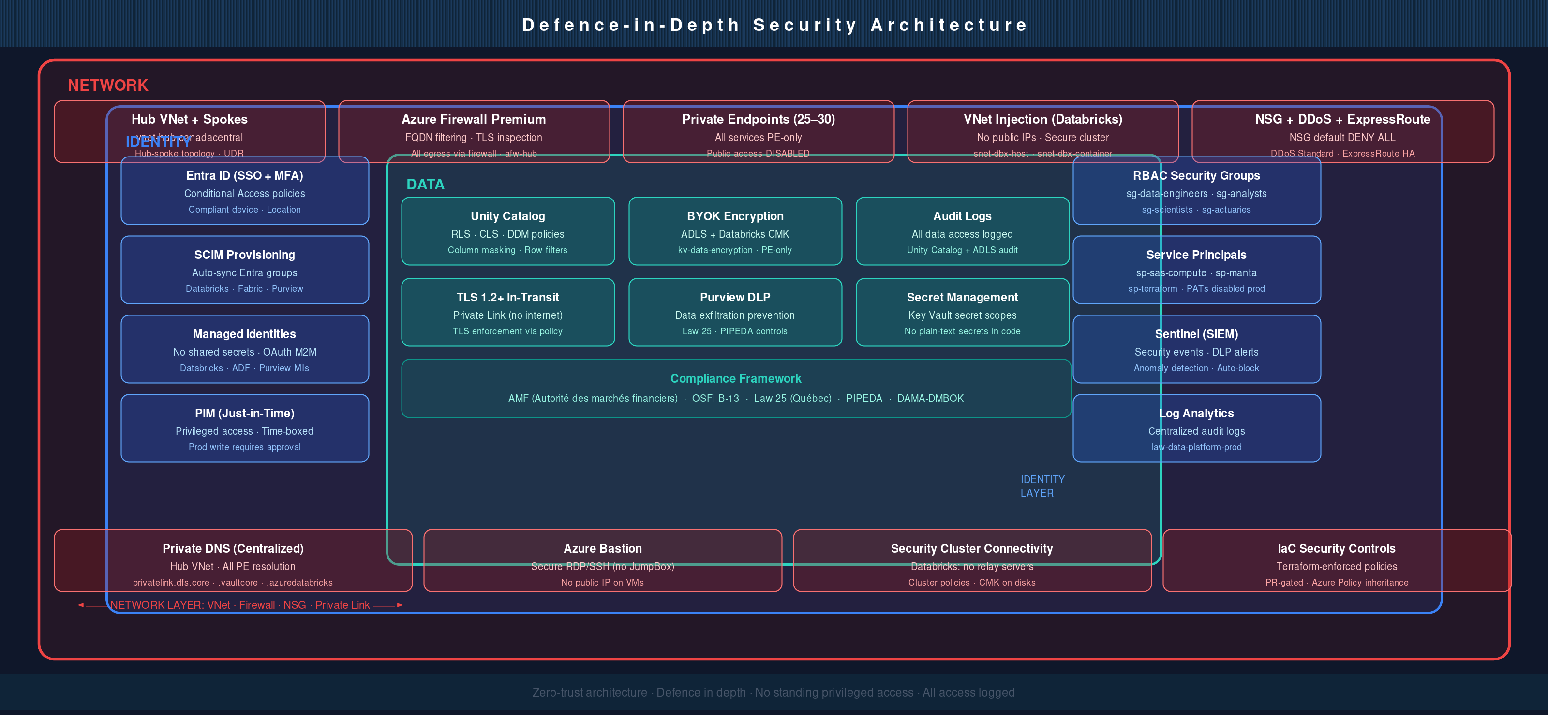
Security Architecture

Slide 42
Identity & Access Management
ENTRA ID
SCIM
DATABRICKS
UC GRANTS
Users/Groups
▶
Provisioning
▶
Workspace groups
▶
Permissions
MFA enabled
Sync
Groups
Access
Advanced Access Control
• Privileged Identity Management (PIM) for admin roles
• Conditional Access policies (IP, device, location, risk-based)
• Service Principal authentication for CI/CD pipelines
• Token-based authentication (no passwords in code)
• Audit log of all authentication attempts + permission changes

Slide 43
Network Security Architecture
HUB VNet
SPOKE VNet (Databricks ADB-managed)
Firewall
(central egress)
NSGs (Ingress/Egress rules)
UDRs (0.0.0.0/0 → Firewall)
Private DNS zones
Private Link endpoints
Bastion
(jump host)
▶
▼
On-Premises
(ExpressRoute)

Slide 44
Encryption & Key Management
Encryption at Rest
Encryption in Transit
• ADLS Gen2: BYOK with Key Vault
• TLS 1.2+ for all connections
• Databricks workspace: CMK for disks
• Private Link for Azure services
• Event Hubs: managed encryption
• VNet Service Endpoints
• Log Analytics: service-managed keys
• ExpressRoute for on-prem connectivity
Key Vault Hierarchy
• Prod Key Vault (Canada Central) ↔ Secrets, keys, certificates
• DR Key Vault (Canada East) — geo-replicated for failover
• Databricks Secret Scope → Key Vault integration
• ADF + SAS Viya authentication via Key Vault references

Slide 45
Regulatory Compliance
AMF (Autorité des marchés financiers)
OSFI (Office of the Superintendent)
Law 25 (Loi 25 - Quebec privacy)
Data protection requirements
Business continuity planning
Consent management
Audit trail logging
DR testing
Data minimization
Access controls
Security assessments
Right to deletion

Slide 46
8
SECTION 8
FinOps & Operations
Cost management, monitoring, disaster recovery
Greenfield | Modern Data Platform | Databricks-primary v8.0

Slide 47
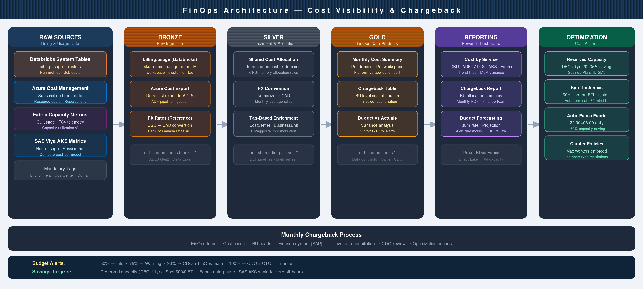
FinOps Architecture

Slide 48
Monitoring & Observability
DATABRICKS
AZURE
CUSTOM
System tables
Metrics
App metrics
Job runs
Logs
DQ scores
Queries
Traces
SLA %
▼
LOG ANALYTICS
Workspace
KQL queries
▼
GRAFANA
AZURE DASHBOARDS
Live dashboards
▶
Portal dashboards
▼
PAGERDUTY
▶
TEAMS

Slide 49
Disaster Recovery
CANADA CENTRAL (PRIMARY)
CANADA EAST (DR)
Databricks workspace + clusters
Standby Databricks workspace
ADLS Gen2 (primary storage)
ADLS Gen2 (geo-replicated)
AKS cluster (SAS Viya)
AKS cluster (standby)
SQL Warehouse (analytics)
▶
Failover orchestration
Full data platform stack
Automated failover scripts
RPO: 4 hours
RTO: 2 hours
Failover Procedure
1. Detect failure: Azure health probes + Databricks API monitoring
2. Activate DR workspace: restore metadata from backup
3. Redirect data load jobs: point to Canada East ADLS
4. Verify sync: compare row counts + checksums
5. Post-failover: sync any 4-hour RPO gap once primary recovered

Slide 50
Architecture Validated and Approved
Ready for implementation
Next Steps
• Establish governance council and data steward roles
• Provision environments (dev, uat, prod) in Azure
• Onboard first business unit datasets to Bronze layer
• Validate Purview + Unity Catalog integration end-to-end
Greenfield | Modern Data Platform | Databricks-primary v8.0 | March 2026

