Slide 1
Greenfield Modern Data Platform
Databricks-Primary Technical Deep Dive (v8.0)
Architecture, Infrastructure, Security, and Delivery Mechanics

Slide 2
Technical Agenda
76-slide engineering and architecture walkthrough
• Architecture boundaries and workload placement
• Medallion implementation details (ingestion to serving)
• Governance, lineage, and data quality controls
• Security/privacy implementation patterns
• Azure infrastructure, network, and operations
• Performance, reliability, FinOps, and DevSecOps
• Execution roadmap and architecture decision gates
Greenfield | Databricks-Primary Technical Deep Dive | Internal - Confidential

Slide 3
Scope and Assumptions
• Primary architecture option: Databricks-primary v8.0.
• Fabric scope constrained to BI serving via Direct Lake.
• SAS Viya retained for regulated actuarial/risk use cases.
• Canadian-only residency: Canada Central (prod), Canada East (DR).
• Control baseline aligned to AMF, OSFI, Law 25, and PIPEDA.
Greenfield | Databricks-Primary Technical Deep Dive | Internal - Confidential

Slide 4
Business and Technical Objectives
Business Outcomes
Technical Outcomes
• Trusted enterprise data products
• Faster analytics and AI delivery cycle
• Regulatory-grade traceability and evidence
• Platform simplification and controlled spend
• Single Delta substrate with governed access
• Composable medallion pipelines
• Lineage and DQ from source to report
• Automated policy and IaC enforcement
Greenfield | Databricks-Primary Technical Deep Dive | Internal - Confidential

Slide 5
Architecture Principles (Operationalized)
• Data as Product: ownership, contracts, certification, SLAs.
• Security by Design: identity-first, zero trust, fine-grained controls.
• Federated Execution: centralized guardrails, domain delivery autonomy.
• Open Standards: Delta/Parquet, APIs, metadata portability.
• Right Workload on Right Platform: explicit anti-overlap boundaries.
Greenfield | Databricks-Primary Technical Deep Dive | Internal - Confidential

Slide 6
Decision Logic: Workload Placement
Identify
workload type
Map to
platform capability
Apply security
constraints
Validate cost
profile
Approve via
ARB gate
Greenfield | Databricks-Primary Technical Deep Dive | Internal - Confidential

Slide 7
Key Architecture Decisions (Condensed)
AD | Decision | Technical Consequence
AD-01 | Delta as canonical format | Unified storage semantics and replay
AD-02 | Databricks primary | Consolidated ETL/SQL/ML runtime
AD-03 | Fabric BI-only | Direct Lake at enterprise scale
AD-04 | SAS Compute Server | Sequential regulated compute path
AD-05 | Purview+UC+Manta | Multi-plane governance + lineage
AD-06 | Canada-only regions | Policy-enforced residency
AD-07 | ADLS shared substrate | Cross-platform non-duplicative access
Greenfield | Databricks-Primary Technical Deep Dive | Internal - Confidential

Slide 8
Non-Functional Priorities
Relative target maturity by design intent
NFR Maturity Snapshot
Security
Reliability
Performance
Cost Efficiency
Operability
Greenfield | Databricks-Primary Technical Deep Dive | Internal - Confidential

Slide 9
Logical Architecture
Layer model, boundaries, and interactions

Slide 10
Seven-Layer Reference Model
Layering aligned to DAMA-DMBOK and EDM-DCAM
1. Ingestion
Batch, CDC, streaming, APIs; provenance and control metadata
2. Bronze
Immutable raw Delta persistence with replay capability
3. Silver
Conformance, quality, survivorship, and enrichment
4. Gold
Business-ready products, marts, aggregates, feature sets
5. Semantic
Business vocabulary and certified KPI definitions
6. Serving
BI, SQL, APIs, SAS, and model consumption endpoints
7. AI/ML
Experimentation, training, deployment, and monitoring
Greenfield | Databricks-Primary Technical Deep Dive | Internal - Confidential

Slide 11
Cross-Cutting Planes
Plane | Responsibilities | Primary Systems
Governance | Catalog, glossary, lineage, quality, stewardship | Purview, Unity Catalog, Manta
Security & Privacy | Identity, ABAC/RLS/CLS/DDM, DLP, consent | Entra ID, UC, Purview DLP
Operations | Monitoring, SLAs, incident, runbook automation | Azure Monitor, Databricks Workflows
Greenfield | Databricks-Primary Technical Deep Dive | Internal - Confidential

Slide 12
Capability Mapping by Platform
Capability | Databricks | Fabric | SAS Viya
ETL/ELT | Primary | Restricted | Targeted
Warehousing | Primary | Serving-only | -
BI | Secondary | Primary | Targeted
ML/AI | Primary | - | Specialized
Lineage | Contributing | Contributing | Contributing via Manta
Semantic Intelligence | Contributing | Evaluate H2/H3 | -
Greenfield | Databricks-Primary Technical Deep Dive | Internal - Confidential

Slide 13
Inter-Platform Data Flow
No duplicated warehouse copies
Sources
ADF / Auto Loader
ADLS Delta
Databricks Bronze/Silver/Gold
Fabric Direct Lake + SAS JDBC
Greenfield | Databricks-Primary Technical Deep Dive | Internal - Confidential

Slide 14
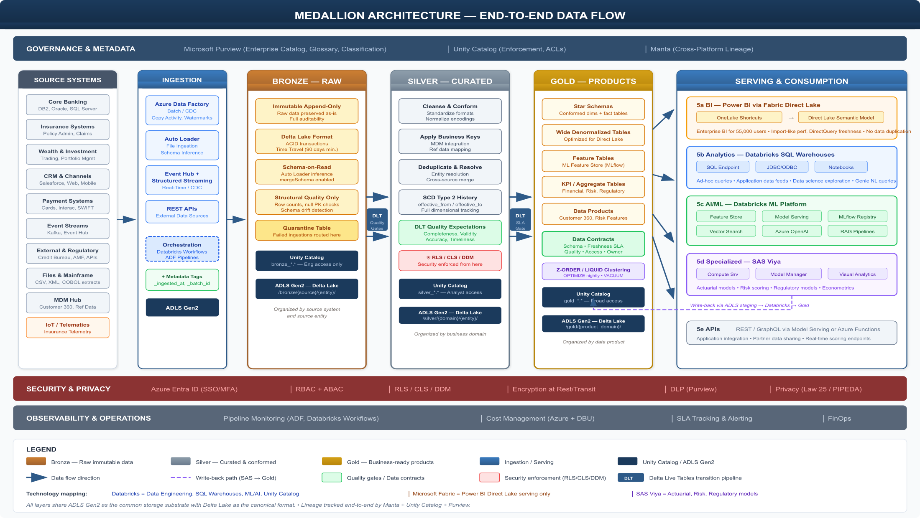
Medallion Architecture (Reference Diagram)
End-to-end governed flow
Greenfield | Databricks-Primary Technical Deep Dive | Internal - Confidential

Slide 15
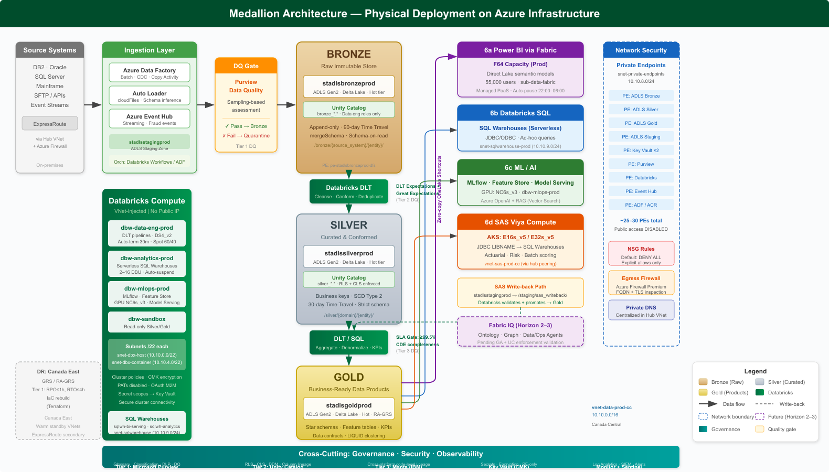
Medallion Architecture (Detailed Variant)
Alternative technical rendering
Greenfield | Databricks-Primary Technical Deep Dive | Internal - Confidential

Slide 16
Fabric Scope Boundary (Allowed vs Prohibited)
Architecture guardrail enforcement required
Allowed
Power BI models, reports, Direct Lake, minimal Dataflows Gen2
Conditionally Allowed
Eventhouse/KQL for targeted operational dashboards
Prohibited
Parallel Fabric warehouse/lakehouse and duplicated ETL
Prohibited
Fabric Data Factory as primary orchestrator
Prohibited
Fabric notebooks replacing Databricks engineering runtime
Greenfield | Databricks-Primary Technical Deep Dive | Internal - Confidential

Slide 17
Direct Lake Rationale at Enterprise Scale
• Power BI DirectQuery against Databricks SQL at 55k users is cost-latency intensive.
• Direct Lake minimizes per-query round trips while preserving freshness.
• Fabric’s role is economic BI serving optimization, not data platform duplication.
• Capacity governance prevents expansion into unauthorized engineering use.
Greenfield | Databricks-Primary Technical Deep Dive | Internal - Confidential

Slide 18
Logical Request Path: Analyst to Governed Data
Security and governance remain in-path
User Auth via Entra
Semantic Model
Direct Lake / SQL
UC Policy Evaluation
Delta Read + Mask
Greenfield | Databricks-Primary Technical Deep Dive | Internal - Confidential

Slide 19
Technical Debt Avoidance
Anti-Patterns to Block
Mitigation Mechanisms
• Shadow ETL in Fabric
• Unmanaged extracts to local marts
• Direct ADLS sensitive access from unmanaged runtimes
• Unversioned security policies
• ARB design gate + exception workflow
• Policy-as-code + IaC scanning
• Centralized service principal governance
• Continuous lineage and DQ evidence
Greenfield | Databricks-Primary Technical Deep Dive | Internal - Confidential

Slide 20
Medallion Implementation
Ingestion, transformations, and productization mechanics

Slide 21
Source and Ingestion Schema
Sources
Core banking, insurance, cards, CRM, digital channels, external feeds
Ingestion Runtime
ADF, Auto Loader, Structured Streaming, API pulls
Staging + Audit
Landing, provenance metadata, extraction checksums
DQ Pre-Gate
Purview sampling, structural checks, anomaly thresholds
Bronze Commit
Append-only Delta commit with replay metadata
Greenfield | Databricks-Primary Technical Deep Dive | Internal - Confidential

Slide 22
Ingestion Patterns and Design
Pattern | Mechanism | Control Concerns | Typical Domains
Batch Files | Auto Loader cloudFiles | Schema drift, duplicate drops | Partners, regulatory feeds
Batch DB | ADF Copy + watermark/CDC | Latency window, idempotency | Core banking, policy admin
Near Real-time | Debezium/Event Hub/Streaming | Exactly-once semantics | Transactions, status updates
Streaming | Event Hub + SS | Backpressure, ordering | Fraud and telemetry
API | ADF Web / notebook clients | Rate limits, retry strategies | Market and bureau data
SAS Native | JDBC/authorized ADLS | RLS bypass risk on ADLS path | Actuarial inputs
Greenfield | Databricks-Primary Technical Deep Dive | Internal - Confidential

Slide 23
Pre-Bronze Quality Gate Sequence
Tier-1 control before immutable storage
Ingestion Complete
Purview DQ Trigger
Sample & Profile
Threshold Decision
Promote or Quarantine
Greenfield | Databricks-Primary Technical Deep Dive | Internal - Confidential

Slide 24
Sampling and Threshold Model
Domain Type | Sample Strategy | Blocking Criteria
Critical Data Elements | 10-20% (or 100% low-volume) | Null/format/referential failure
Non-CDE Attributes | 1-5% | Structural anomaly warnings
Streaming Windows | Every 1000 records or 5 min | Volume or schema spikes
All Loads | Row-count baseline checks | ±50% anomaly triggers quarantine
Greenfield | Databricks-Primary Technical Deep Dive | Internal - Confidential

Slide 25
Bronze Layer Engineering Details
• Storage layout by source/entity with deterministic partitioning strategy.
• Minimal transformation: metadata columns and type normalization only.
• Append-only contracts enable full replay and forensic analysis.
• Time travel retention baseline 90 days with domain overrides.
• Quarantine tables maintain failed payloads for root-cause analysis.
Greenfield | Databricks-Primary Technical Deep Dive | Internal - Confidential

Slide 26
Bronze Data Contracts
Contract Field | Purpose | Validation
source_system | Trace producer lineage | Mandatory, controlled vocabulary
ingested_at | Pipeline timing | UTC timestamp required
batch_id | Reconciliation and idempotency | Uniqueness within source/entity
source_file/hash | File-level replay evidence | Checksum comparison
schema_version | Evolution management | Must map to catalog history
Greenfield | Databricks-Primary Technical Deep Dive | Internal - Confidential

Slide 27
Silver Transformation Schema
Standardize
Type coercion, timezone normalization, canonical naming
Conform
Reference joins, key harmonization, entity resolution
Validate
Business rules, expectations, anomaly checks
Enrich
Master/reference datasets and derived attributes
Publish Silver
Conformed tables for downstream aggregation
Greenfield | Databricks-Primary Technical Deep Dive | Internal - Confidential

Slide 28
DLT Pipeline Topology
Declarative dependency and quality tracking
Bronze Stream
DLT Bronze Views
DLT Silver Tables
Quality Expectations
Metrics + Lineage
Greenfield | Databricks-Primary Technical Deep Dive | Internal - Confidential

Slide 29
Silver Quality Rules (Examples)
Rule | Type | Failure Action
customer_id not null | Completeness | Drop + alert
account_status in set | Validity | Quarantine record
txn_date <= current_date | Reasonableness | Warn and flag
policy_id unique by source | Uniqueness | Deduplicate with survivorship
reference code exists | Referential | Reject for steward remediation
Greenfield | Databricks-Primary Technical Deep Dive | Internal - Confidential

Slide 30
Gold Layer Construction Patterns
• Star schemas for reporting domains with conformed dimensions.
• Data products combine domain marts, KPI tables, and feature-ready sets.
• Certification process includes Tier-3 SLA checks before release.
• Semantic naming and KPI definitions synchronized with BI semantic layer.
• Gold outputs are controlled sources for APIs, BI, and ML features.
Greenfield | Databricks-Primary Technical Deep Dive | Internal - Confidential

Slide 31
Gold Certification Criteria
Criterion | Target | Owner
CDE completeness | >=99.5% | Domain Data Owner
Freshness SLA | Within contractual window | Data Engineering Lead
Lineage completeness | Source-to-KPI trace available | Governance Office
Policy compliance | RLS/CLS/DDM mapped | Security Architect
Operational readiness | Monitoring + runbooks approved | Platform Operations
Greenfield | Databricks-Primary Technical Deep Dive | Internal - Confidential

Slide 32
End-to-End Medallion Release Path
Release gate with evidence at each stage
Ingest
Bronze Commit
Silver Conformance
Gold Certification
Consumer Publish
Greenfield | Databricks-Primary Technical Deep Dive | Internal - Confidential

Slide 33
Governance and Lineage
Metadata planes and operational controls

Slide 34
Three-Tier Governance Architecture
Rationalized model replacing overlapping catalog duplication
Tier 1: Purview
Enterprise catalog, glossary, classification, DQ dashboards
Tier 2: Unity Catalog
Technical grants, lineage, row/column security controls
Tier 3: Manta
Cross-platform code-level lineage and impact analysis
Greenfield | Databricks-Primary Technical Deep Dive | Internal - Confidential

Slide 35
Lineage Federation Pipeline
Databricks + ADF + SAS integration
Scan Code/Metadata
Parse Dependencies
Build Unified Graph
Publish to Purview
Expose to Engineers
Greenfield | Databricks-Primary Technical Deep Dive | Internal - Confidential

Slide 36
Metadata Responsibilities
Function | Purview | Unity Catalog | Manta
Business glossary | Primary | Reference | -
Technical object ACLs | Reference | Primary | -
Column-level lineage | Consume | Primary (Databricks scope) | Aggregate across tools
Cross-platform lineage | Consume | Consume | Primary
Steward workflows | Primary | Support | -
Greenfield | Databricks-Primary Technical Deep Dive | Internal - Confidential

Slide 37
Governance Operating Model
• Central policy office defines standards, controls, and review criteria.
• Domain teams deliver products under mandatory architecture and DQ gates.
• Exceptions require formal risk acceptance and remediation timeline.
• Stewardship KPIs tracked for issue aging, data quality trend, and ownership.
Greenfield | Databricks-Primary Technical Deep Dive | Internal - Confidential

Slide 38
Data Quality Tier Controls
Control Domain | Design | Runtime Enforcement | Evidence
Tier 1 Ingestion | Purview sampling profiles | Pipeline-triggered gates | DQ scorecards + quarantine logs
Tier 2 Transformation | DLT expectations + GE suites | Job fail/warn policies | DLT event logs + alerts
Tier 3 Certification | SLA & semantic checks | Publish block on threshold miss | Certification artifacts
Governance | Steward review cadence | Issue workflow SLA | Meeting minutes + tracker
Greenfield | Databricks-Primary Technical Deep Dive | Internal - Confidential

Slide 39
Master and Reference Data Governance
• Enterprise entities managed as reusable certified products.
• Reference tables versioned with controlled release workflow.
• Survivorship logic implemented in Silver with reconciliation evidence.
• Downstream consumers subscribe to contract versions, not ad-hoc extracts.
Greenfield | Databricks-Primary Technical Deep Dive | Internal - Confidential

Slide 40
Change Impact Assessment Workflow
Manta graph enables deterministic blast-radius analysis
Proposed Change
Lineage Impact Query
Consumer Risk Scoring
ARB Approval
Controlled Deployment
Greenfield | Databricks-Primary Technical Deep Dive | Internal - Confidential

Slide 41
Governance KPIs
KPI | Definition | Target
Certified data products | Gold products passing Tier-3 checks | Quarterly growth with >95% compliance
Steward issue closure | DQ/security issue closure within SLA | >90% within SLA
Lineage completeness | Products with full source-to-consumption lineage | 100% for regulated domains
Policy exception aging | Open exceptions older than threshold | <5% over 90 days
Greenfield | Databricks-Primary Technical Deep Dive | Internal - Confidential

Slide 42
Security and Privacy Engineering
Control implementation details

Slide 43
Security Control Stack
Identity
Entra ID, Conditional Access, MFA, SCIM
Resource Authorization
Azure RBAC and workspace-level permissions
Data Authorization
ABAC, RLS, CLS, DDM in Unity Catalog
Network
Private endpoints, NSGs, firewall egress control
Protection & Privacy
Encryption, DLP, consent, DSAR workflows
Audit
Central logs, SIEM correlation, compliance evidence
Greenfield | Databricks-Primary Technical Deep Dive | Internal - Confidential

Slide 44
Identity and Access Patterns
Component | Auth Pattern | Notes
Databricks | SAML/OAuth via Entra | SCIM group sync to principals
Fabric | Native Entra integration | Capacity and workspace RBAC
SAS Viya | SAML/OIDC federation | Group claims mapped to SAS roles
Purview | Native Entra | Collection-level governance roles
ADF | Managed identity runtime | Authoring RBAC via Entra groups
Greenfield | Databricks-Primary Technical Deep Dive | Internal - Confidential

Slide 45
Conditional Access Baseline
Control Domain | Design | Runtime Enforcement | Evidence
MFA | All data platform apps | Token issuance blocked if absent | Entra sign-in logs
Compliant Device | Managed endpoints only | Access denied for non-compliant | Intune compliance reports
Trusted Network | Corp/VPN/Bastion source | Block external unknown IPs | Conditional access outcomes
Session Lifetime | 12h interactive max | Forced reauthentication | Token policy logs
Greenfield | Databricks-Primary Technical Deep Dive | Internal - Confidential

Slide 46
ABAC Implementation in Unity Catalog
• Attribute sources include role, business unit, region, and clearance class.
• Policies are attached to catalogs/schemas/tables via grant templates.
• Attribute propagation follows joiner-mover-leaver lifecycle automation.
• Design separates coarse RBAC from fine-grained row/column policies.
Greenfield | Databricks-Primary Technical Deep Dive | Internal - Confidential

Slide 47
RLS Policy Examples
Dataset | Filter Logic | Applied For
Customer Gold | region in user_regions() | Regional operations teams
Claims Gold | business_unit = current_bu() | P&C vs Life segmentation
Risk Mart | risk_role in entitlement_map() | Second-line risk functions
Actuarial Inputs | project_code in user_projects() | Model-specific SAS teams
Greenfield | Databricks-Primary Technical Deep Dive | Internal - Confidential

Slide 48
CLS and Masking Profiles
Classification | Mask Strategy | Illustrative Fields
Public/Internal | No mask | Reference dimensions
Confidential | Partial reveal | Postal code, phone
Restricted | Deterministic hash/null | SIN, account number
Highly Sensitive | Tokenized/proxy view only | Health/disability fields
Greenfield | Databricks-Primary Technical Deep Dive | Internal - Confidential

Slide 49
Sensitive Query Enforcement Path
Policy decision stays server-side at query runtime
User Query
UC AuthZ Check
Row Filter Apply
Column Mask Apply
Result Delivery
Greenfield | Databricks-Primary Technical Deep Dive | Internal - Confidential

Slide 50
Network and Exfiltration Controls
• Public endpoints disabled for ADLS, Key Vault, Purview, ADF, Event Hub.
• All spoke egress forced through Azure Firewall Premium with FQDN rules.
• NSGs maintain deny-by-default and explicit service flow allowances.
• Fabric export and sharing controls restricted by tenant security settings.
Greenfield | Databricks-Primary Technical Deep Dive | Internal - Confidential

Slide 51
Privacy Engineering: Law 25 and PIPEDA
• Consent flags are propagated as policy attributes in curated layers.
• DSAR workflows include discovery, extraction, and response evidence chain.
• Erasure requests orchestrate delete/purge with retention rule exceptions.
• Pseudonymization and anonymization patterns applied by data product type.
Greenfield | Databricks-Primary Technical Deep Dive | Internal - Confidential

Slide 52
Security Monitoring and Audit
Control Domain | Design | Runtime Enforcement | Evidence
Access Logs | Databricks, Fabric, SAS, ADLS | SIEM correlation and anomaly rules | Central log retention
Privilege Changes | Entra + UC grants | Daily drift detection jobs | Access review packs
Policy Violations | Azure Policy + config scans | Automated incident ticketing | Exception registry
Data Exfiltration | Firewall + DLP telemetry | High-risk alert workflows | Forensic packet/log evidence
Greenfield | Databricks-Primary Technical Deep Dive | Internal - Confidential

Slide 53
Azure Infrastructure Deep Dive
Landing zone, network, compute, and resilience

Slide 54
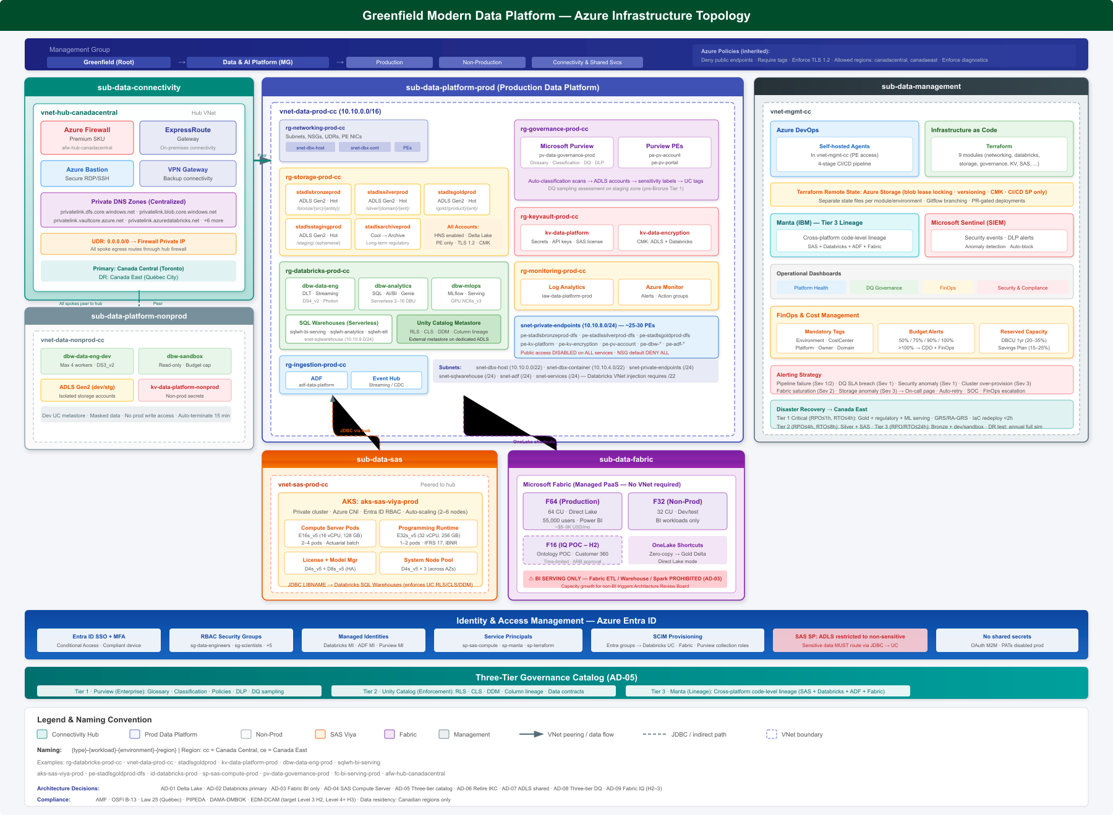
Azure Topology Overview
Physical deployment baseline
Greenfield | Databricks-Primary Technical Deep Dive | Internal - Confidential

Slide 55
Hub-Spoke Network Topology
VNet | Purpose | Key Assets
vnet-hub-canadacentral | Shared connectivity and security | Firewall, ER Gateway, Bastion, DNS
vnet-data-prod-cc | Production data workloads | Databricks, PEs, SQL paths
vnet-data-nonprod-cc | Non-prod workloads | Dev/stg/sandbox workspaces
vnet-sas-prod-cc | SAS compute isolation | AKS/VM compute + JDBC paths
vnet-mgmt-cc | Ops and automation | CI runners, monitoring, tooling
Greenfield | Databricks-Primary Technical Deep Dive | Internal - Confidential

Slide 56
Production Subnet Schema
snet-dbx-host-prod (/22)
Databricks host VMs, delegated subnet
snet-dbx-container-prod (/22)
Container network for Spark runtime
snet-private-endpoints (/24)
PE NICs for data and control services
snet-sqlwarehouse-prod (/24)
Serverless SQL connectivity config
snet-adf-prod (/24)
Integration runtime agents
snet-services-prod (/24)
Utility services and internal components
Greenfield | Databricks-Primary Technical Deep Dive | Internal - Confidential

Slide 57
Private Endpoint Matrix
Service | Sub-resource | DNS Zone
ADLS Gen2 | dfs/blob | privatelink.dfs/blob.core.windows.net
Key Vault | vault | privatelink.vaultcore.azure.net
Purview | account/portal | privatelink.purview*.azure.com
Databricks | workspace UI/API | privatelink.azuredatabricks.net
Event Hub | namespace | privatelink.servicebus.windows.net
Data Factory | dataFactory/portal | privatelink.datafactory/adf.azure.com
Greenfield | Databricks-Primary Technical Deep Dive | Internal - Confidential

Slide 58
Firewall Rule Collections
Control Domain | Design | Runtime Enforcement | Evidence
Databricks Control Plane | Allow region endpoints | HTTPS 443 egress only | Firewall policy logs
Azure Core Services | Allow identity/monitoring FQDNs | Restricted outbound set | Policy analytics
Package Repositories | Allow approved package domains | Curated dependency access | Change review records
Default Deny | Block all unmatched egress | No implicit internet access | Blocked flow evidence
Greenfield | Databricks-Primary Technical Deep Dive | Internal - Confidential

Slide 59
Compute Profiles
Runtime | Sizing Pattern | Workload
Data Engineering | DS4/DS5 pools + autoscale | DLT/ETL and quality workflows
Analytics SQL | Serverless small-medium | Ad-hoc and dashboard acceleration
MLOps | CPU/GPU mixed pools | Training, feature generation, serving
SAS Compute Server | E-series memory optimized | Actuarial and risk batch
Fabric Capacity | F-SKU sized for BI only | Direct Lake serving
Greenfield | Databricks-Primary Technical Deep Dive | Internal - Confidential

Slide 60
Disaster Recovery Sequence
Primary: Canada Central | DR: Canada East
Detect Incident
Activate DR Runbook
Restore Data Paths
Recover Compute
Validate SLAs
Greenfield | Databricks-Primary Technical Deep Dive | Internal - Confidential

Slide 61
Resilience Targets
Control Domain | Design | Runtime Enforcement | Evidence
RPO | Data loss tolerance by domain | Geo-redundant storage strategy | Backup/replication metrics
RTO | Service restoration target | Automated infra and workload playbooks | DR drill outcomes
Critical Pipelines | Priority recovery order | Dependency-aware restart | Operational logs
Security During DR | Policies remain enforced | Failover with private networking | Control attestations
Greenfield | Databricks-Primary Technical Deep Dive | Internal - Confidential

Slide 62
Infrastructure as Code and CI/CD
Stage | Objective | Gate
Validate | Lint, policy checks, static analysis | Fail-fast non-compliance
Plan | Deterministic diff and approvals | Peer + architecture review
Apply Non-Prod | Integration and smoke tests | Automated test pass
Apply Prod | Controlled rollout | Dual approval + change window
Greenfield | Databricks-Primary Technical Deep Dive | Internal - Confidential

Slide 63
Operations, Performance, and Execution
Run model and delivery plan

Slide 64
Performance Engineering Levers
Layer | Optimization Lever | Expected Benefit
Ingestion | Incremental loading and checkpointing | Reduced latency and retries
Bronze/Silver | Partitioning and file sizing | Efficient scan and compaction
Gold | Materialized aggregates and caching | Faster BI and API response
SQL Warehouses | Autosuspend/scaling policies | Balanced throughput/cost
ML Serving | Adaptive autoscale | SLA adherence under burst
Greenfield | Databricks-Primary Technical Deep Dive | Internal - Confidential

Slide 65
Observability and SRE Controls
Control Domain | Design | Runtime Enforcement | Evidence
Pipeline Health | Task-level metrics and SLA timers | Alert routing by severity | Ops dashboard + incident logs
Data Quality | Rule breach telemetry | Quarantine and steward ticket | DQ trend boards
Cost | Tag-based spend and anomalies | Budget thresholds and alerts | FinOps monthly packs
Security | SIEM correlation and threat alerts | SOC incident response | Audit evidence
Greenfield | Databricks-Primary Technical Deep Dive | Internal - Confidential

Slide 66
Incident Management Workflow
Integrated with platform and security operations
Detect
Triage
Contain
Recover
Postmortem
Greenfield | Databricks-Primary Technical Deep Dive | Internal - Confidential

Slide 67
FinOps Model
Cost Drivers
Optimization Actions
• Compute DBU consumption by workload class
• Storage growth and retention profile
• Fabric BI capacity utilization
• Network egress and private endpoint scale
• Cluster policies and auto-termination
• Workload scheduling and right-sizing
• Storage lifecycle and compaction
• Chargeback transparency by domain
Greenfield | Databricks-Primary Technical Deep Dive | Internal - Confidential

Slide 68
Delivery Roadmap
Horizon | Focus | Milestones
H1 (0-12m) | Foundation | Landing zone, core pipelines, governance baseline
H2 (12-24m) | Scale | Domain product expansion, semantic acceleration
H3 (24-36m) | Optimize | Advanced AI governance and automation depth
Greenfield | Databricks-Primary Technical Deep Dive | Internal - Confidential

Slide 69
Architecture Review Board Gates
• Gate 1: workload placement and anti-pattern checks.
• Gate 2: security/privacy controls and policy mapping.
• Gate 3: data quality, lineage, and certification readiness.
• Gate 4: operational readiness, SLOs, and runbook completeness.
• Gate 5: post-implementation evidence and KPI outcomes.
Greenfield | Databricks-Primary Technical Deep Dive | Internal - Confidential

Slide 70
Executive Technical Decisions
Steering committee inputs required
Decision Point | Option Recommended | Technical Rationale
Primary Platform | Databricks-primary | End-to-end control and reduced overlap
BI Serving | Fabric Direct Lake | Cost/performance at enterprise scale
Governance Stack | Purview + UC + Manta | Full business + technical lineage
SAS Integration | JDBC-first policy | Preserve UC row/column enforcement
Delivery Strategy | Phased with ARB gates | Risk-controlled execution
Greenfield | Databricks-Primary Technical Deep Dive | Internal - Confidential

Slide 71
Closing: Implementation Priorities
Next technical action baseline
• Confirm guardrails in architecture standards and CI controls.
• Sequence high-value domains for Gold product certification.
• Harden lineage and DQ evidence for regulated reporting.
• Operationalize FinOps and reliability SLO dashboards.
• Prepare Fabric IQ evaluation backlog under strict governance.
Greenfield | Databricks-Primary Technical Deep Dive | Internal - Confidential

