Slide 1
Greenfield Modern Data Platform
Databricks-Primary Architecture (v8.0)
Executive Architecture Deck | March 2026
Classification: Internal - Confidential | Owner: VP, Chief Data Officer

Slide 2
Presentation Agenda
A
50-slide executive briefing
1. Strategic context and architecture decisions
2. Logical architecture and medallion implementation
3. Governance, quality, and security/privacy controls
4. Azure infrastructure deployment model
5. Operating model, roadmap, and executive decisions
Greenfield | Data & AI Solutions | Internal - Confidential

Slide 3
Executive Summary
E
Databricks is the primary platform for engineering, warehousing, and AI/ML workloads.
Microsoft Fabric is scoped to BI serving (Power BI Direct Lake) with strict guardrails.
SAS Viya Compute Server remains for regulated actuarial and risk analytics.
Purview + Unity Catalog + Manta delivers full governance and cross-platform lineage.
Architecture is designed for AMF, OSFI, and Law 25 compliance in Canadian regions.
Greenfield | Data & AI Solutions | Internal - Confidential

Slide 4
Strategic Drivers and Outcomes
Primary Drivers
Target Outcomes
Regulatory compliance and auditability
Enterprise-scale data democratization
AI-readiness across business units
Cost discipline through clear platform boundaries
Single governed source of truth
Faster delivery of reusable data products
Risk-managed self-service analytics
Scalable architecture for 55,000 employees
Greenfield | Data & AI Solutions | Internal - Confidential

Slide 5
Vision and Guiding Principles
V
Data as a Product with clear ownership and quality accountability.
Unified governance with federated execution where capabilities are mature.
Security by design with RLS, CLS, DDM, and zero-trust controls.
Right tool for the right workload to avoid capability overlap.
AI-ready-by-default architecture across engineering and serving layers.
Greenfield | Data & AI Solutions | Internal - Confidential

Slide 6
Key Architecture Decisions (AD-01 to AD-09)
Decision | Direction | Executive Intent
AD-01 | Delta Lake as canonical format | Portability, consistency, and open standards
AD-02 | Databricks as primary platform | Consolidate ETL, SQL, and ML execution
AD-03 | Fabric as BI serving layer | Optimize Power BI cost/performance at scale
AD-04 | SAS Viya Compute Server | Support regulated actuarial/risk workloads
AD-05 | Purview + UC + Manta | End-to-end governance and lineage
AD-06 | Canadian-only regions | Satisfy residency and resilience constraints
AD-07 | ADLS Gen2 shared substrate | Single physical data foundation
Greenfield | Data & AI Solutions | Internal - Confidential

Slide 7
Logical Architecture
Layered design and platform responsibilities

Slide 8
Seven Logical Layers
Layer | Purpose | Primary Technologies
Ingestion | Acquire and track changes | ADF, Auto Loader, Event Hub
Bronze | Immutable raw storage | ADLS Gen2 Delta, Unity Catalog
Silver | Conformance and quality | DLT, dbt, Great Expectations
Gold | Business-ready products | Databricks SQL, Fabric Direct Lake
Semantic | KPI business language | Power BI Semantic Models, dbt Metrics
Serving | End-user consumption | Power BI, SQL, APIs, SAS VA
AI/ML | Model lifecycle | MLflow, Feature Store, Model Serving
Greenfield | Data & AI Solutions | Internal - Confidential

Slide 9
Cross-Cutting Controls
Governance & Metadata
Security & Operations
Enterprise catalog and business glossary in Purview
Technical governance and grants in Unity Catalog
Unified lineage graph through Manta integration
Identity, RBAC/ABAC, masking, and encryption
Observability for pipelines, cost, and SLAs
Policy enforcement via automation and review gates
Greenfield | Data & AI Solutions | Internal - Confidential

Slide 10
Platform Responsibility Matrix
Capability | Databricks | Fabric | SAS Viya
Data Engineering | Primary | Restricted | Targeted
Data Warehousing | Primary | BI serving only | -
BI & Reporting | Secondary | Primary | Targeted
ML / AI | Primary | - | Specialized
Lineage | Contributing | Contributing | Manta source
Semantic Intelligence | Contributing | Evaluate (H2/H3) | -
Greenfield | Data & AI Solutions | Internal - Confidential

Slide 11
Data Flow Between Platforms
Single source of truth with governed consumption paths
Sources
ADF / Auto Loader
ADLS + Delta
Databricks
Silver/Gold
Fabric Direct Lake
+ SAS JDBC
Greenfield | Data & AI Solutions | Internal - Confidential

Slide 12
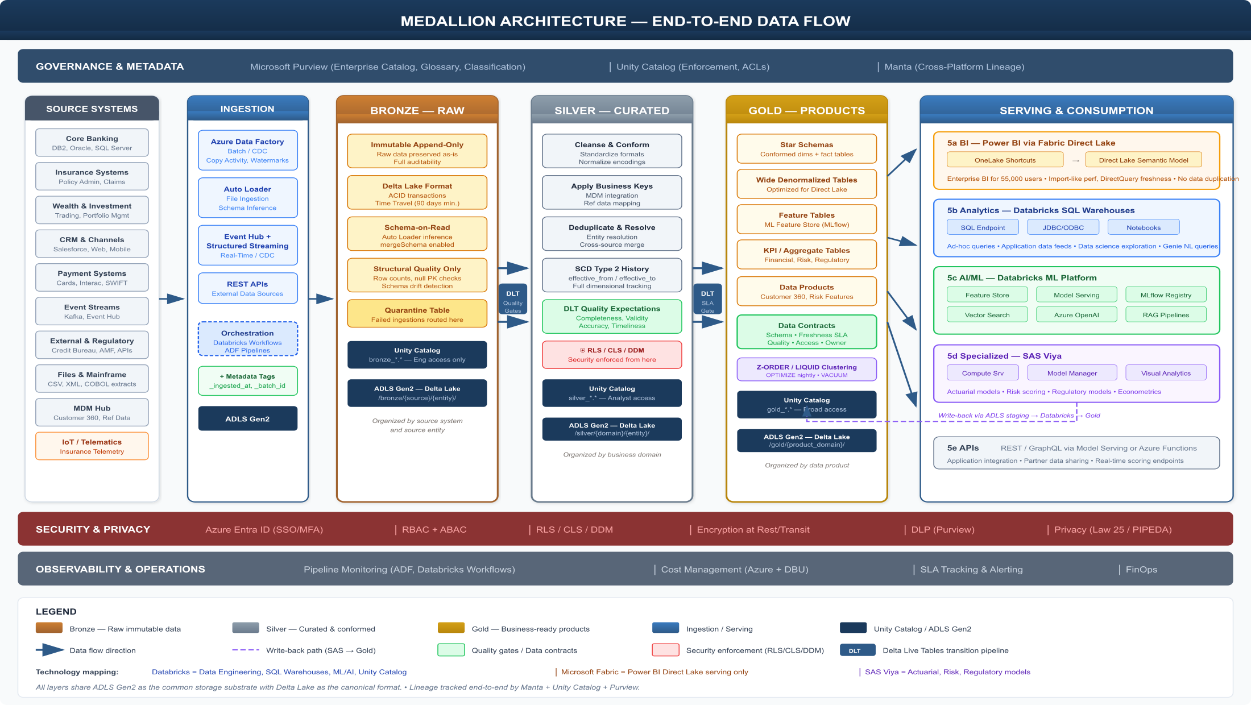
Medallion Architecture: End-to-End View
Source systems to serving channels with governance, security, and observability overlays.
Greenfield | Data & AI Solutions | Internal - Confidential

Slide 13
Ingestion Patterns
I
Batch file ingestion with Auto Loader schema inference/evolution.
Database CDC and incremental extraction with Azure Data Factory.
Streaming ingestion through Event Hub and Structured Streaming.
API ingestion orchestrated with Databricks Workflows or ADF.
SAS-native ingestion via JDBC LIBNAME or authorized ADLS paths.
Greenfield | Data & AI Solutions | Internal - Confidential

Slide 14
Pre-Bronze Data Quality Gate
Tier-1 DQ before raw persistence
Land to Staging
Purview DQ Sampling
Pass/Fail Decision
Bronze or Quarantine
Steward Alerting
Greenfield | Data & AI Solutions | Internal - Confidential

Slide 15
Bronze Layer Implementation
B
Immutable append-only Delta storage by source and entity.
Ingestion metadata columns for provenance and replay.
Schema evolution enabled with controlled drift handling.
90-day Delta time travel baseline with domain-specific retention.
Quarantine sub-tables for structural failures.
Greenfield | Data & AI Solutions | Internal - Confidential

Slide 16
Silver Layer Implementation
S
Standardization, cleansing, deduplication, and key conformance.
DLT expectations enforce quality rules during transformation.
Reference/master data enrichment and survivorship logic.
PII normalization and policy tagging for downstream controls.
Lineage captured to support full audit traceability.
Greenfield | Data & AI Solutions | Internal - Confidential

Slide 17
Gold Layer and Data Products
G
Business-ready dimensional and analytical models.
Certified KPIs with semantic alignment and stewardship signoff.
Feature-ready curated datasets for AI/ML consumption.
Power BI Direct Lake consumption through OneLake shortcuts.
SAS consumption via JDBC path to preserve Unity Catalog controls.
Greenfield | Data & AI Solutions | Internal - Confidential

Slide 18
Serving Channels and Interfaces
Consumer | Interface | Governance Pattern
Power BI | Fabric Direct Lake | Purview + Semantic model governance
Analysts | Databricks SQL | Unity Catalog grants, row/column controls
Applications | APIs / JDBC / ODBC | Service principals and contracts
Data Science | Notebooks + Feature Store | Model governance and lineage
Actuarial Teams | SAS Viya Compute Server | JDBC first; restricted ADLS exception
Greenfield | Data & AI Solutions | Internal - Confidential

Slide 19
Governance & Data Quality
Three-tier control model across platforms

Slide 20
Governance Operating Model
G
Centralized governance standards with federated delivery execution.
Data ownership defined at domain and product levels.
Stewardship workflows tied to quality and policy exceptions.
Architecture review gates prevent workload drift and duplication.
Greenfield | Data & AI Solutions | Internal - Confidential

Slide 21
Three-Tier Catalog Strategy
Complementary strengths instead of overlapping catalogs
Purview
Enterprise Plane
Unity Catalog
Technical Enforcement
Manta
Cross-Platform Lineage
Greenfield | Data & AI Solutions | Internal - Confidential

Slide 22
Tier 1: Microsoft Purview
P
Enterprise inventory, glossary, classification, and policy management.
Data quality dashboards and stewardship collaboration workflows.
Visibility layer for business and compliance stakeholders.
Lineage consumption endpoint for integrated Manta metadata.
Greenfield | Data & AI Solutions | Internal - Confidential

Slide 23
Tier 2: Databricks Unity Catalog
U
Central metastore and object-level permissions.
Row filters and column masks enforced at query time.
Audit events and lineage for data engineering and SQL workloads.
Primary technical governance plane for Delta assets.
Greenfield | Data & AI Solutions | Internal - Confidential

Slide 24
Tier 3: Manta Lineage Engine
M
Code-level lineage extraction across Databricks, ADF, and SAS.
Bridges lineage gaps no single platform can cover end-to-end.
Feeds lineage views in Purview and technical diagnostics in UC.
Critical for regulated change impact assessment.
Greenfield | Data & AI Solutions | Internal - Confidential

Slide 25
Three-Tier Data Quality Framework
Tier | Execution Point | Gate Outcome
Tier 1 | Ingestion (Purview DQ Sampling) | Block or quarantine defective loads
Tier 2 | Medallion transitions (DLT + GE) | Reject non-conforming records
Tier 3 | Gold certification SLA checks | Publish only certified products
Unified | DQ observability dashboards | Steward accountability and trend control
Greenfield | Data & AI Solutions | Internal - Confidential

Slide 26
Master Data and Reference Data
D
Golden identifiers and reference dimensions centralized in curated zones.
Conformance rules propagated across domains via reusable pipelines.
Customer 360 and core reference entities treated as enterprise products.
Lifecycle governance aligns with DAMA-DMBOK and DCAM practices.
Greenfield | Data & AI Solutions | Internal - Confidential

Slide 27
Security & Privacy
Defense-in-depth controls for regulated operations

Slide 28
Identity and Authentication Foundation
I
Azure Entra ID is the mandatory identity provider across all components.
MFA, compliant device, and conditional access are always enforced.
SCIM/SAML/OAuth integrations standardize workforce access patterns.
Managed identities preferred; static credentials prohibited.
Greenfield | Data & AI Solutions | Internal - Confidential

Slide 29
RBAC Model (Azure Resource Layer)
Security Group | Primary Role | Scope
sg-data-platform-admins | Contributor | Data platform subscriptions
sg-data-engineers | Databricks + Storage Contributor | Engineering workspaces and ADLS
sg-data-scientists | Sandbox contributor + reader | Exploration and governed read zones
sg-governance-admins | Purview curator + KV admin | Governance stack
sg-fabric-admins | Capacity administrator | Fabric BI capacity
Greenfield | Data & AI Solutions | Internal - Confidential

Slide 30
ABAC in Unity Catalog
A
Policy decisions are based on role, business unit, region, and clearance attributes.
Catalog/schema/table hierarchies simplify consistent grant propagation.
Attribute provisioning aligns with joiner-mover-leaver lifecycle.
ABAC path extends to downstream BI and SAS controls via governed interfaces.
Greenfield | Data & AI Solutions | Internal - Confidential

Slide 31
Row-Level Security Strategy
R
Unity Catalog row filters enforce least-privilege data visibility.
Rules use user context and domain attributes at query runtime.
Power BI RLS complements semantic layer access boundaries.
Security logic is centrally versioned and auditable.
Greenfield | Data & AI Solutions | Internal - Confidential

Slide 32
Column Security and Dynamic Masking
C
Column-level policies protect PII and regulated attributes.
Masking modes include nulling, partial reveal, and deterministic hash.
Purview classification labels drive mask policy assignment.
Sensitive fields remain controlled across SQL, BI, and API paths.
Greenfield | Data & AI Solutions | Internal - Confidential

Slide 33
Privacy Controls (Law 25 / PIPEDA)
L
Consent metadata influences access and downstream usage policies.
DSAR workflows support discover, extract, and evidence generation.
Right-to-erasure handled through orchestrated purge and retention rules.
Pseudonymization/anonymization patterns applied by domain sensitivity.
Greenfield | Data & AI Solutions | Internal - Confidential

Slide 34
Encryption and Exfiltration Controls
Encryption
Exfiltration Prevention
AES-256 at rest with MMK/CMK strategy
TLS 1.2+ for all in-transit communications
Key Vault managed key lifecycle and rotation
Private endpoints and disabled public access
Firewall and NSG deny-by-default stance
DLP policies and export restrictions in BI layers
Greenfield | Data & AI Solutions | Internal - Confidential

Slide 35
Security Audit and Monitoring
M
Centralized logs from Entra, Databricks, Fabric, SAS, and Azure services.
Security alerting integrated with incident response operations.
Compliance evidence packs generated for internal/external audits.
Policy-as-code controls continuously validated through CI/CD.
Greenfield | Data & AI Solutions | Internal - Confidential

Slide 36
Azure Infrastructure
Landing zone, network, compute, and operations

Slide 37
Landing Zone Architecture
L
CAF-aligned enterprise landing zone with policy inheritance.
Hub-spoke topology isolates workloads and centralizes control points.
All spokes route egress through Azure Firewall Premium inspection.
Private DNS and Bastion complete the secure connectivity model.
Greenfield | Data & AI Solutions | Internal - Confidential

Slide 38
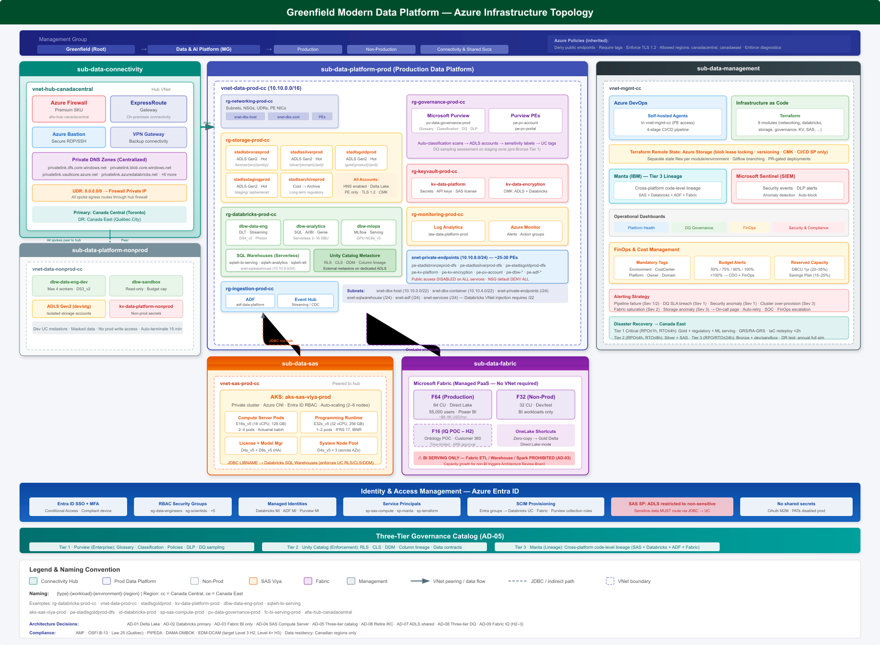
Azure Infrastructure Topology
Physical deployment across subscriptions, VNets, services, and control planes.
Greenfield | Data & AI Solutions | Internal - Confidential

Slide 39
Region and Disaster Recovery Strategy
Domain | Primary | Secondary / DR
Region | Canada Central | Canada East
Role | Production and non-production execution | DR replication and recovery
Compliance | Canadian residency | Canadian residency maintained
Constraint | No non-Canadian replication | Enforced by Azure Policy
Greenfield | Data & AI Solutions | Internal - Confidential

Slide 40
Subscription and Resource Organization
Subscription | Purpose | Key Controls
sub-data-connectivity | Hub networking | Firewall, ER, DNS, Bastion
sub-data-platform-prod | Production platform | Databricks, ADLS, Purview, KV
sub-data-platform-nonprod | Dev/stage/sandbox | Cost and quota boundaries
sub-data-sas-prod | SAS workloads | Isolated compute and RBAC
sub-data-fabric-prod | BI capacity | F-SKU governance
sub-data-management | Ops and monitoring | DevOps, Log Analytics, Sentinel
Greenfield | Data & AI Solutions | Internal - Confidential

Slide 41
Networking and Private Endpoints
N
Databricks VNet injection uses dedicated /22 host and container subnets.
Private endpoint-only access for ADLS, Key Vault, Purview, ADF, and Event Hub.
NSG baseline is deny-all with explicit allow rules per flow.
No direct spoke-to-spoke communication; all traffic inspectable.
Greenfield | Data & AI Solutions | Internal - Confidential

Slide 42
Databricks Compute Sizing and Policies
Workspace | Primary Role | Control Highlights
dbw-data-eng-prod | Pipelines and transformations | Cluster policy guardrails, Photon, autoscaling
dbw-analytics-prod | SQL and dashboards | Serverless SQL, autosuspend, workload mgmt
dbw-mlops-prod | Modeling and serving | GPU pools, model serving autoscale
dbw-data-eng-dev | Dev/test | Reduced limits and strict auto-terminate
dbw-sandbox | Exploration | Read-only sensitive zones, budget caps
Greenfield | Data & AI Solutions | Internal - Confidential

Slide 43
SAS Viya Compute Server Model
Deployment Pattern
Data Access Rules
Private AKS deployment recommended
Compute Server engine (sequential batch)
Memory-optimized pods for actuarial models
Dedicated license and model manager services
JDBC to Databricks SQL is default path
ADLS direct path only for pre-authorized non-sensitive zones
SAS service principal scoped with minimal RBAC
All access paths are logged for audit and lineage
Greenfield | Data & AI Solutions | Internal - Confidential

Slide 44
Fabric Capacity Guardrails
F
Capacity is sized exclusively for BI serving workloads.
No Fabric warehouse/lakehouse duplication of Databricks managed data.
No Fabric Data Factory or notebook shadow engineering layer.
Capacity expansions require architecture board approval.
Greenfield | Data & AI Solutions | Internal - Confidential

Slide 45
Observability, FinOps, and DevOps
Domain | Tooling | Expected Outcome
Monitoring | Azure Monitor + Log Analytics + Databricks metrics | SLA visibility and incident detection
Security Ops | Sentinel + alert rules | Threat detection and response
FinOps | Tags, budgets, cost dashboards | Chargeback and optimization
IaC | Terraform modules + CI/CD | Repeatable and auditable infrastructure
Greenfield | Data & AI Solutions | Internal - Confidential

Slide 46
Roadmap and Decisions
Phased execution with governance gates

Slide 47
Horizon 1 (0-12 Months): Foundation
1
Finalize Databricks-primary architecture baseline and guardrails.
Deploy production landing zone, networking, and core governance stack.
Industrialize Bronze/Silver/Gold pipelines for priority domains.
Implement tiered DQ controls and initial certification process.
Greenfield | Data & AI Solutions | Internal - Confidential

Slide 48
Horizon 2 (12-24 Months): Scale and Intelligence
2
Expand domain data products and semantic KPI coverage.
Increase self-service capabilities within governed boundaries.
Pilot Fabric IQ capabilities under strict access prerequisites.
Strengthen cross-platform lineage and model risk controls.
Greenfield | Data & AI Solutions | Internal - Confidential

Slide 49
Horizon 3 (24-36 Months): Optimize and Innovate
Optimization Focus
Innovation Focus
Platform cost/performance rebalancing
Automated policy assurance and controls testing
Expanded AI/ML productization and monitoring
Domain agent use cases with safe data grounding
Advanced semantic intelligence on certified products
Continuous architecture modernization under guardrails
Greenfield | Data & AI Solutions | Internal - Confidential

Slide 50
Executive Decision Requests
Final steering decisions
Decision | Required Direction | Impact
Architecture Baseline | Approve Databricks-primary v8.0 | Locks platform scope and investment alignment
Fabric Guardrails | Approve BI-serving-only boundary | Prevents duplication and cost drift
Governance Model | Approve Purview + UC + Manta operating model | Enables auditable enterprise control
Roadmap Funding | Approve phased delivery plan | Accelerates time-to-value with risk control
Greenfield | Data & AI Solutions | Internal - Confidential

